Slide 2
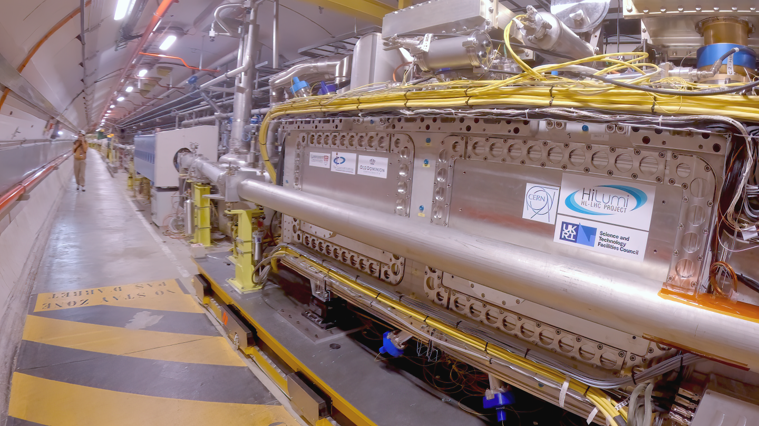
LLRF Activities at CERN LLRF Workshop 2025
Ben Woolley
13/10/2025 10/13/2025

Slide 3
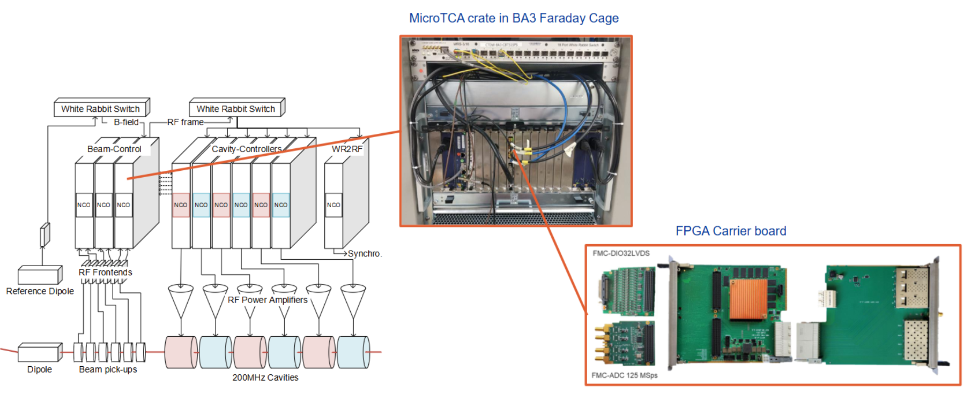
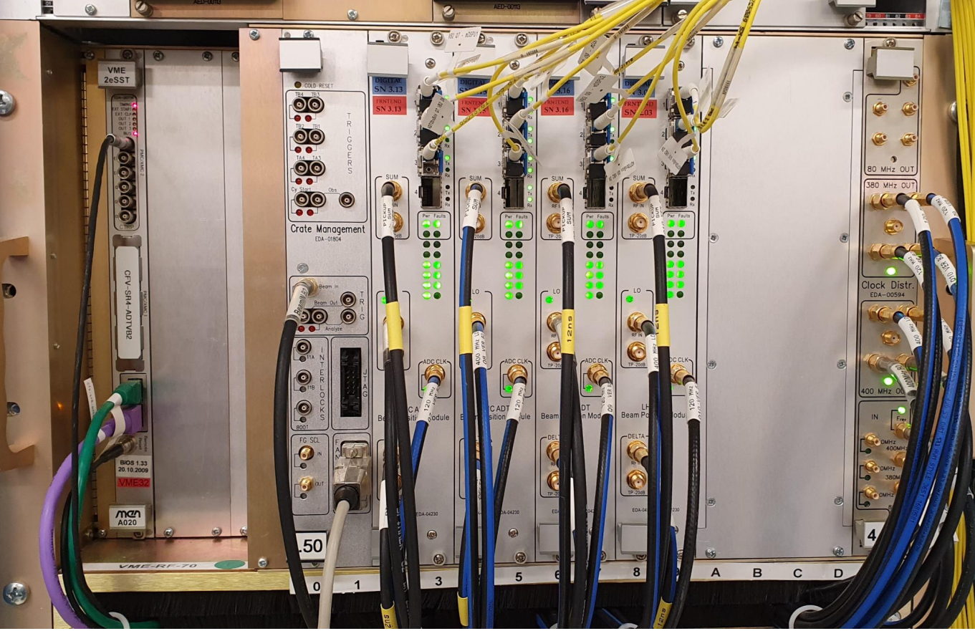
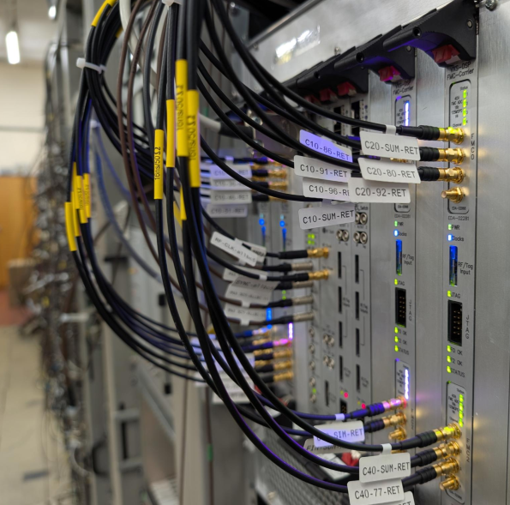
Outline
CERN accelerator complex
Existing systems
Ongoing activities
Upcoming activities: LS3, LS4 and beyond
CERN talks/posters
LHC ADT controller RF-VME
PS RF Beam control VXS

Slide 4
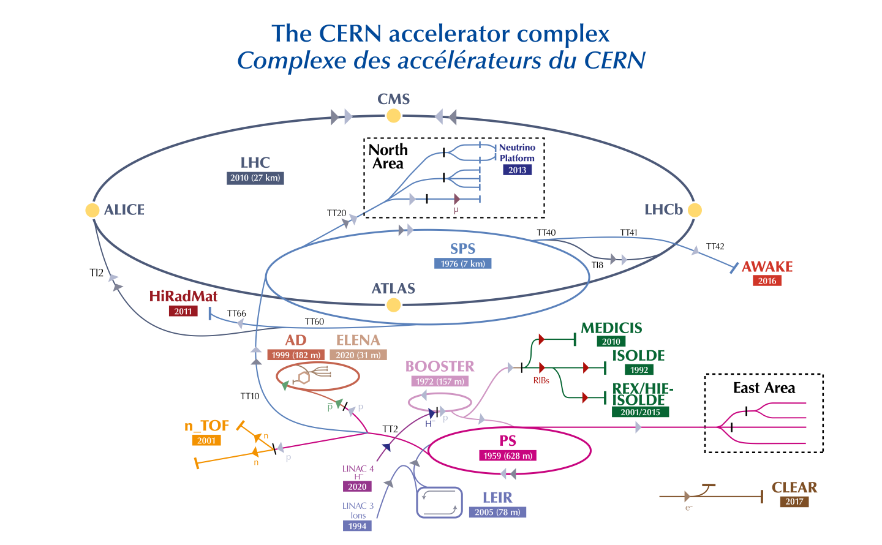

Slide 5
LHC Crabs
LHC ACS/BC
LHC ADT
SPS BA3 ACC/BC
LHC Crabs
SPS BA6 Crab
SPS BA2 ADT
SM18
LINAC4 RFQ2

Slide 6
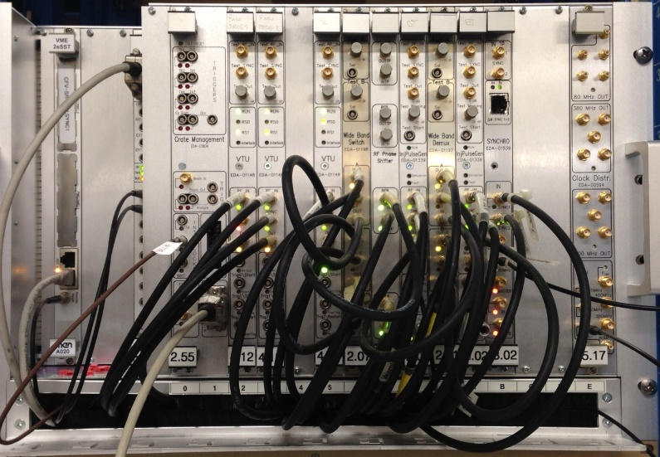
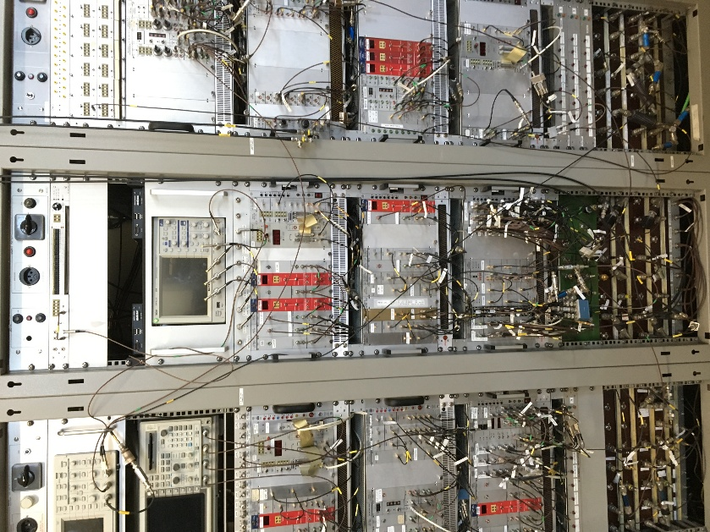
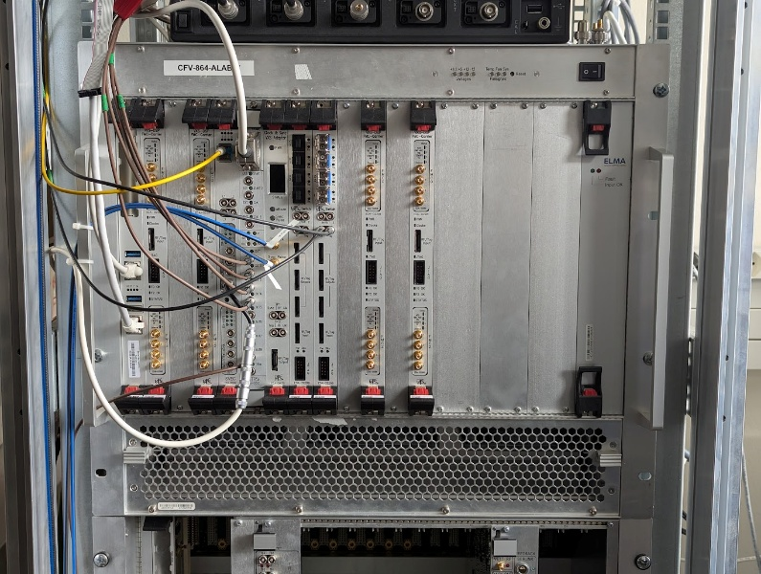
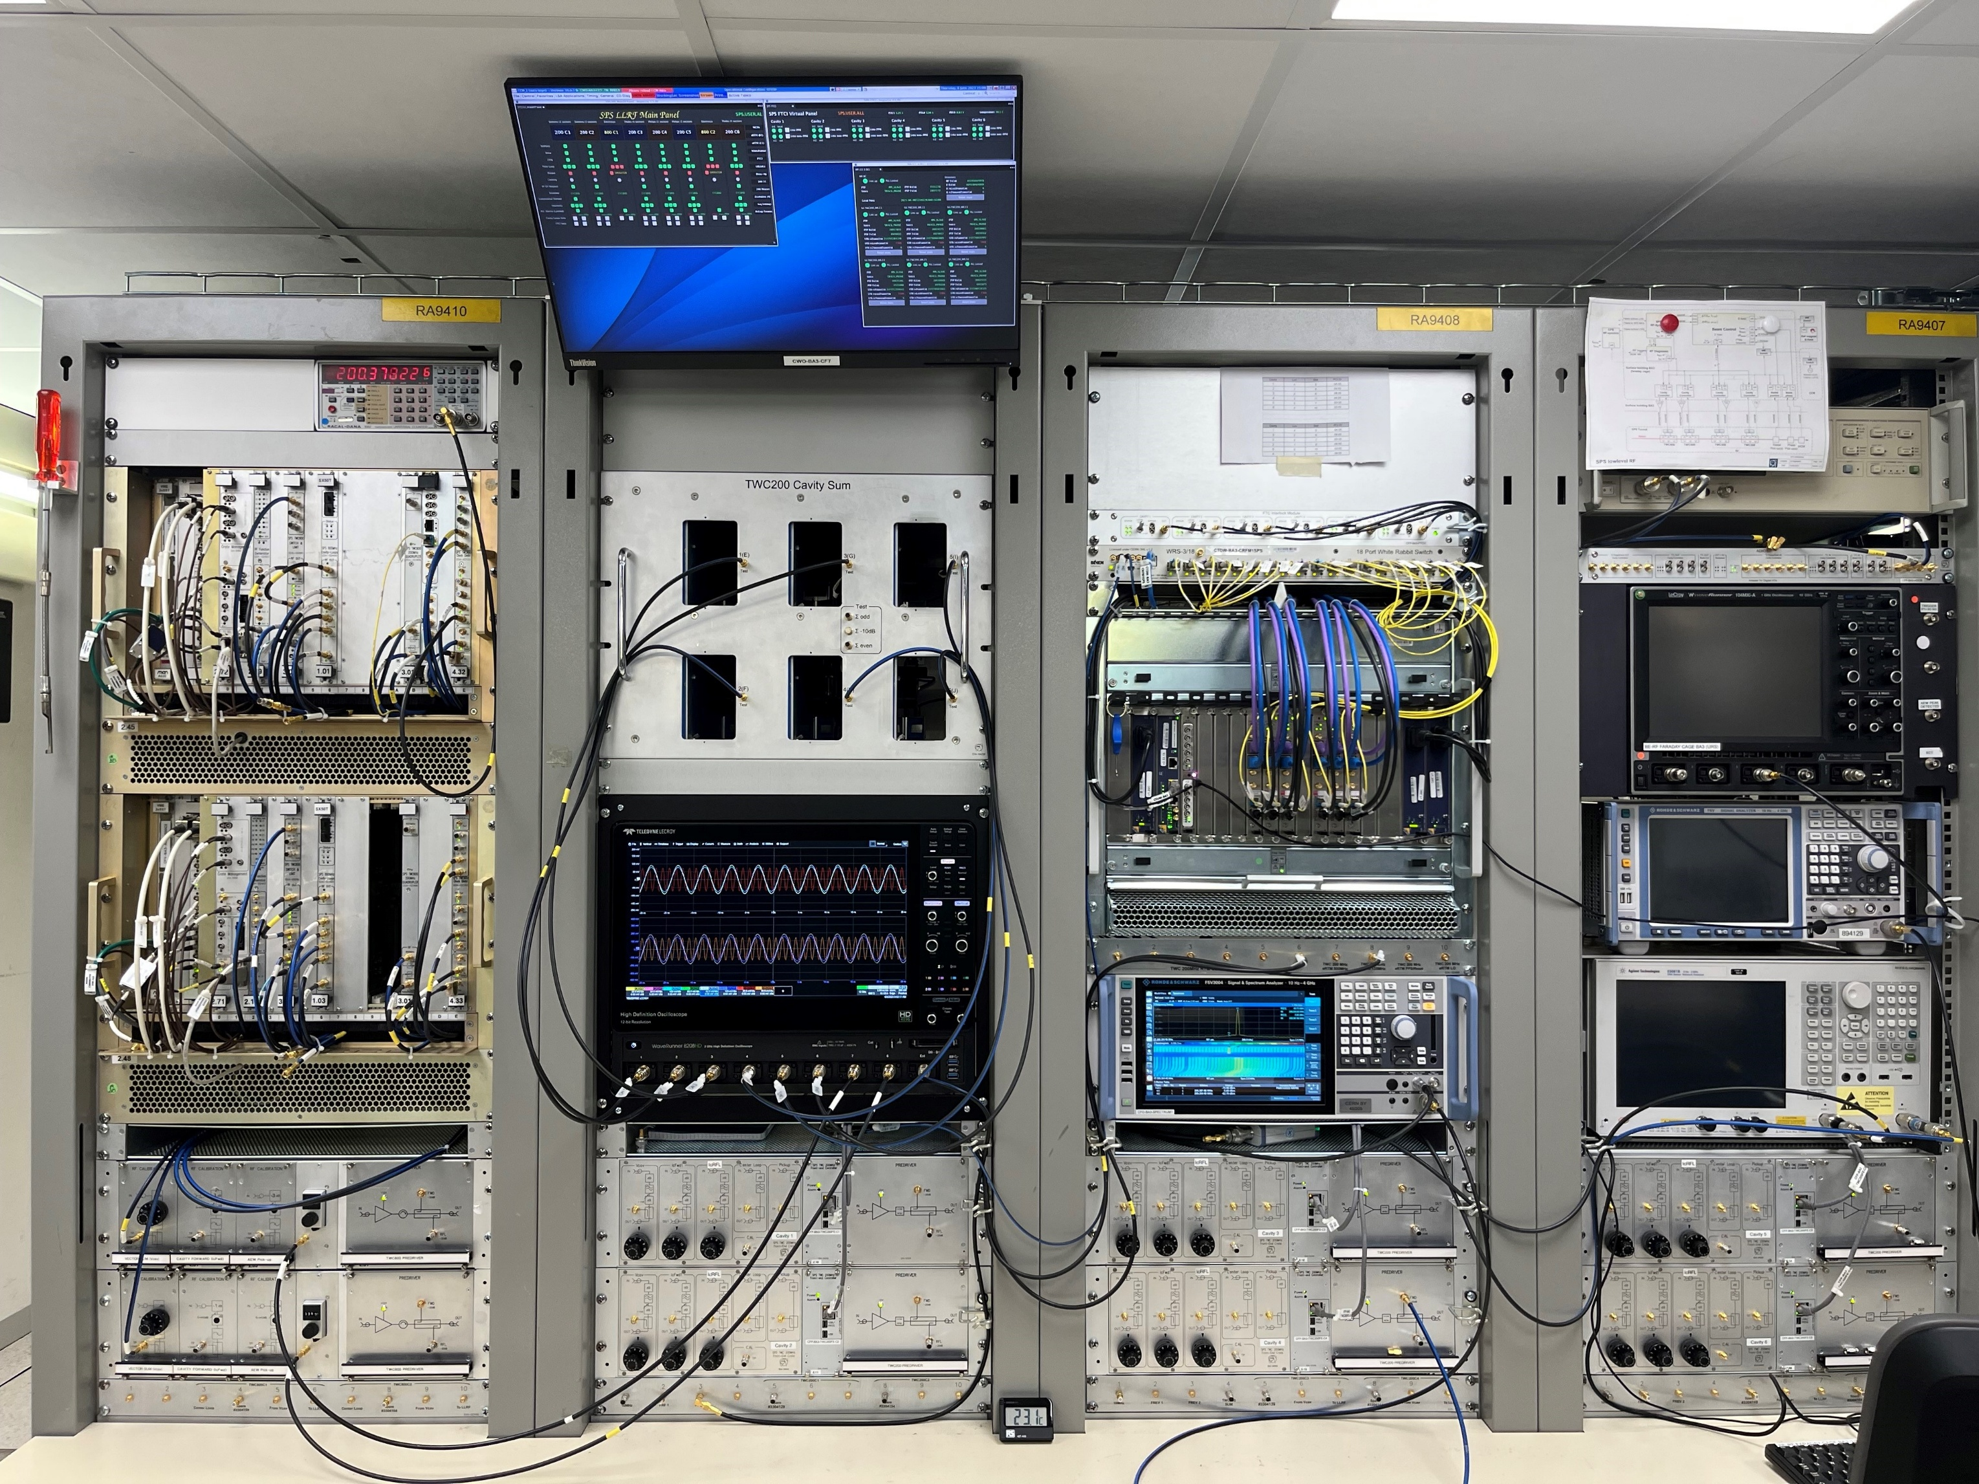
LLRF Controls at CERN
RF controls equipment is spread across all machines
Technology spans across the ages 1970’s – 2020’s
Interesting challenge to operate
“Zoo” of different systems, different standards, different design philosophies
Obsolescences and dwindling spares, inability to re-flash program older devices (FPGA or DSP)
Much of the work is to re-new/upgrade existing systems
But, we also have new projects with state of the art requirements
LHC Clock and Sync Controls RF-VME
PS 20/40/80 MHz Beam Controls NIM
PS New Beam Control VXS
SPS 200 MHz Cavity Controllers MicroTCA

Slide 7
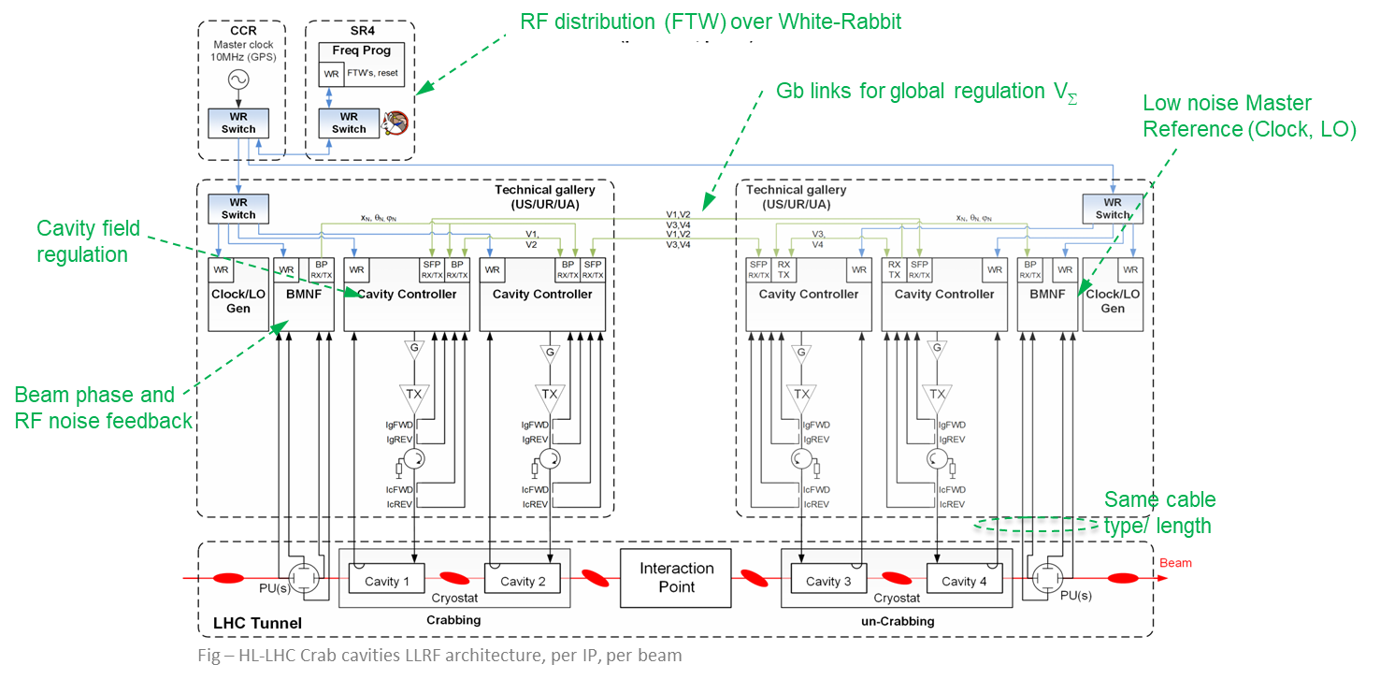
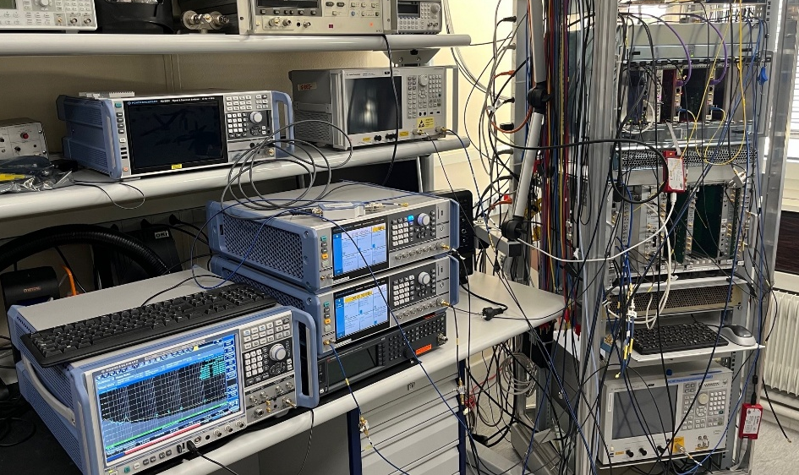
Ongoing activities: HL-LHC
HL-LHC Project: Crab Cavities
Large project: 16 cavities over 2 LHC Interaction points (ATLAS + CMS)
Many new concepts
Collaboration across CERN groups and external collaborators
White rabbit is key to synchronise with Beam
State of the art phase noise is required to preserve beam transverse emittance.
Fig – HL-LHC Crab cavities LLRF architecture, per IP, per beam
RF noise feedback
State of the art bunch-by-bunch measurement of position and tilt
Likely RFSoC will be selected – studies ongoing
Ideally MicroTCA for integration into the Crab Cavity Controller system
Interlock/watchdog system
Worst case (90 degree) phase errors in the crab cavities can push beam into the collimators and destroy them in 10 turns!
Fig – LLRF lab tests

Slide 8
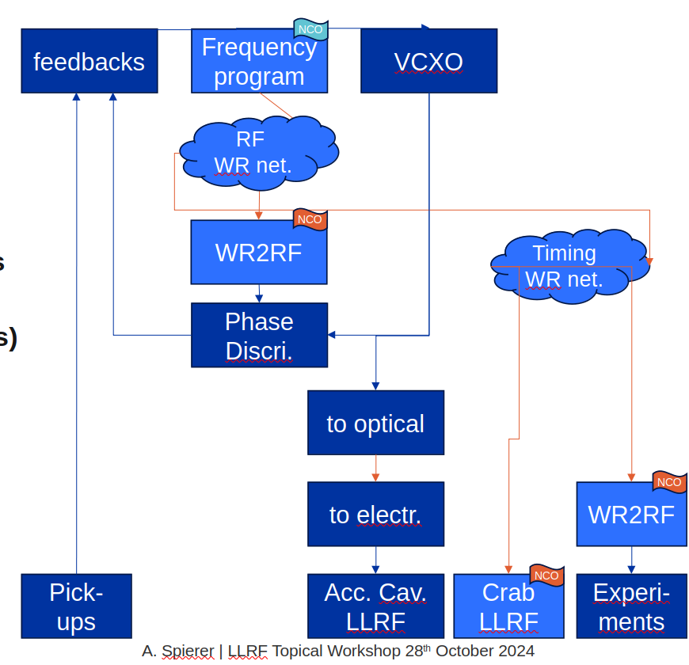
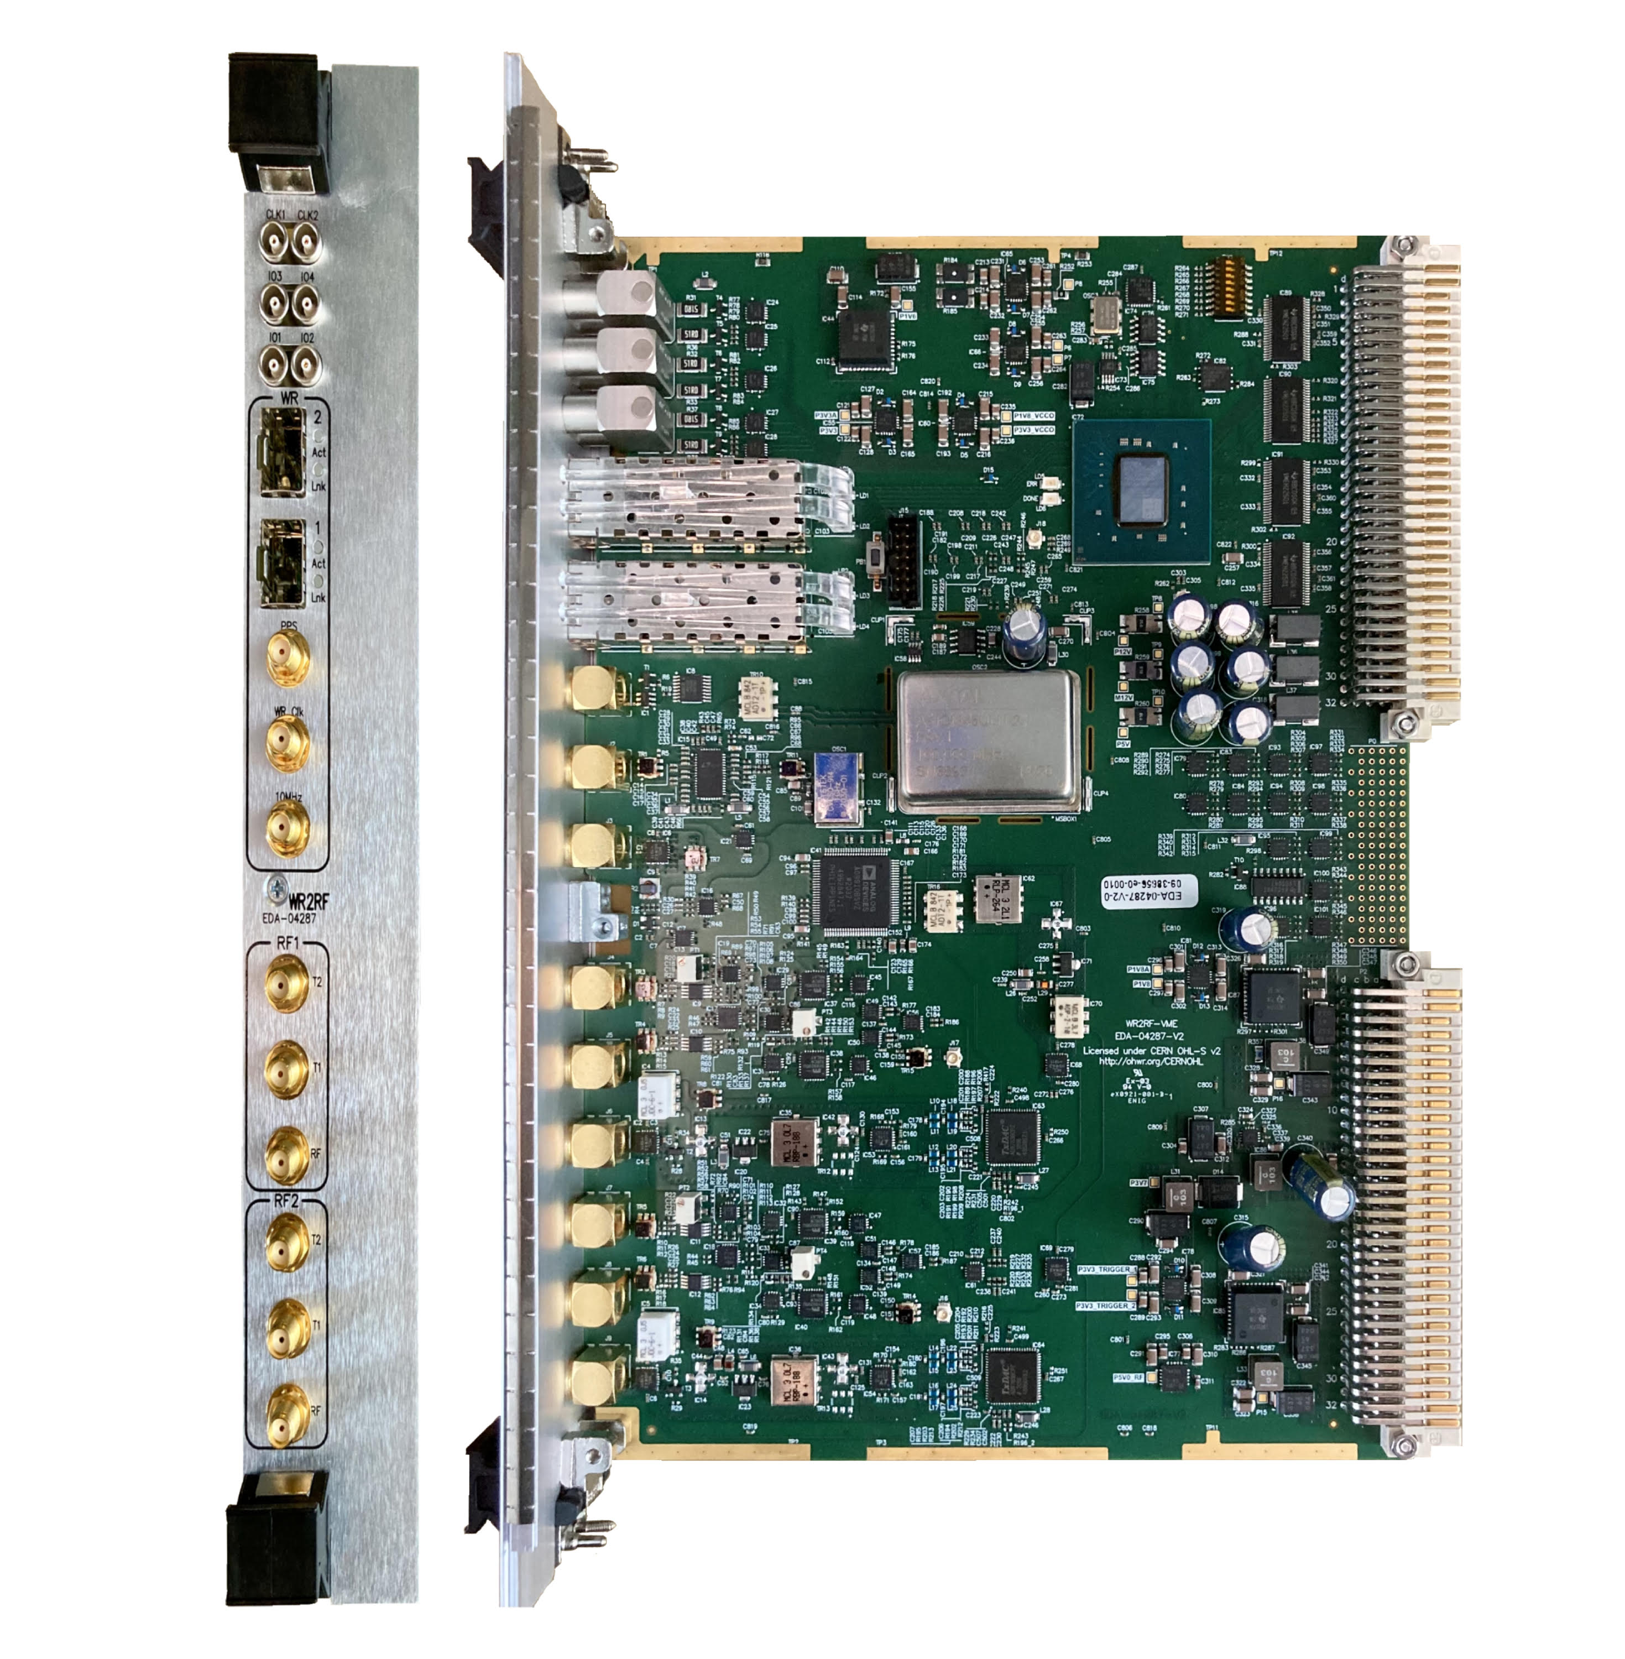
Ongoing Activities: LHC Beam Control Consolidation (Phase 0)
Replacement of the revolution frequency program
WR2RF to generate reference RF for loops and accelerating cavities
Dedicated low-latency WR network (~20 us)
Accelerating cavities LLRF, Beam Control LLRF
Injection of RF over Ethernet (RoE) in the machine timing WR network (~200 us)
For experiments, Crab cavities, instrumentation….
Hardware already installed in LHC, tests underway with CMS.
Tests with beam for frequency programme distribution and beam control in November
Fig – WR2RF VMEx64

Slide 9
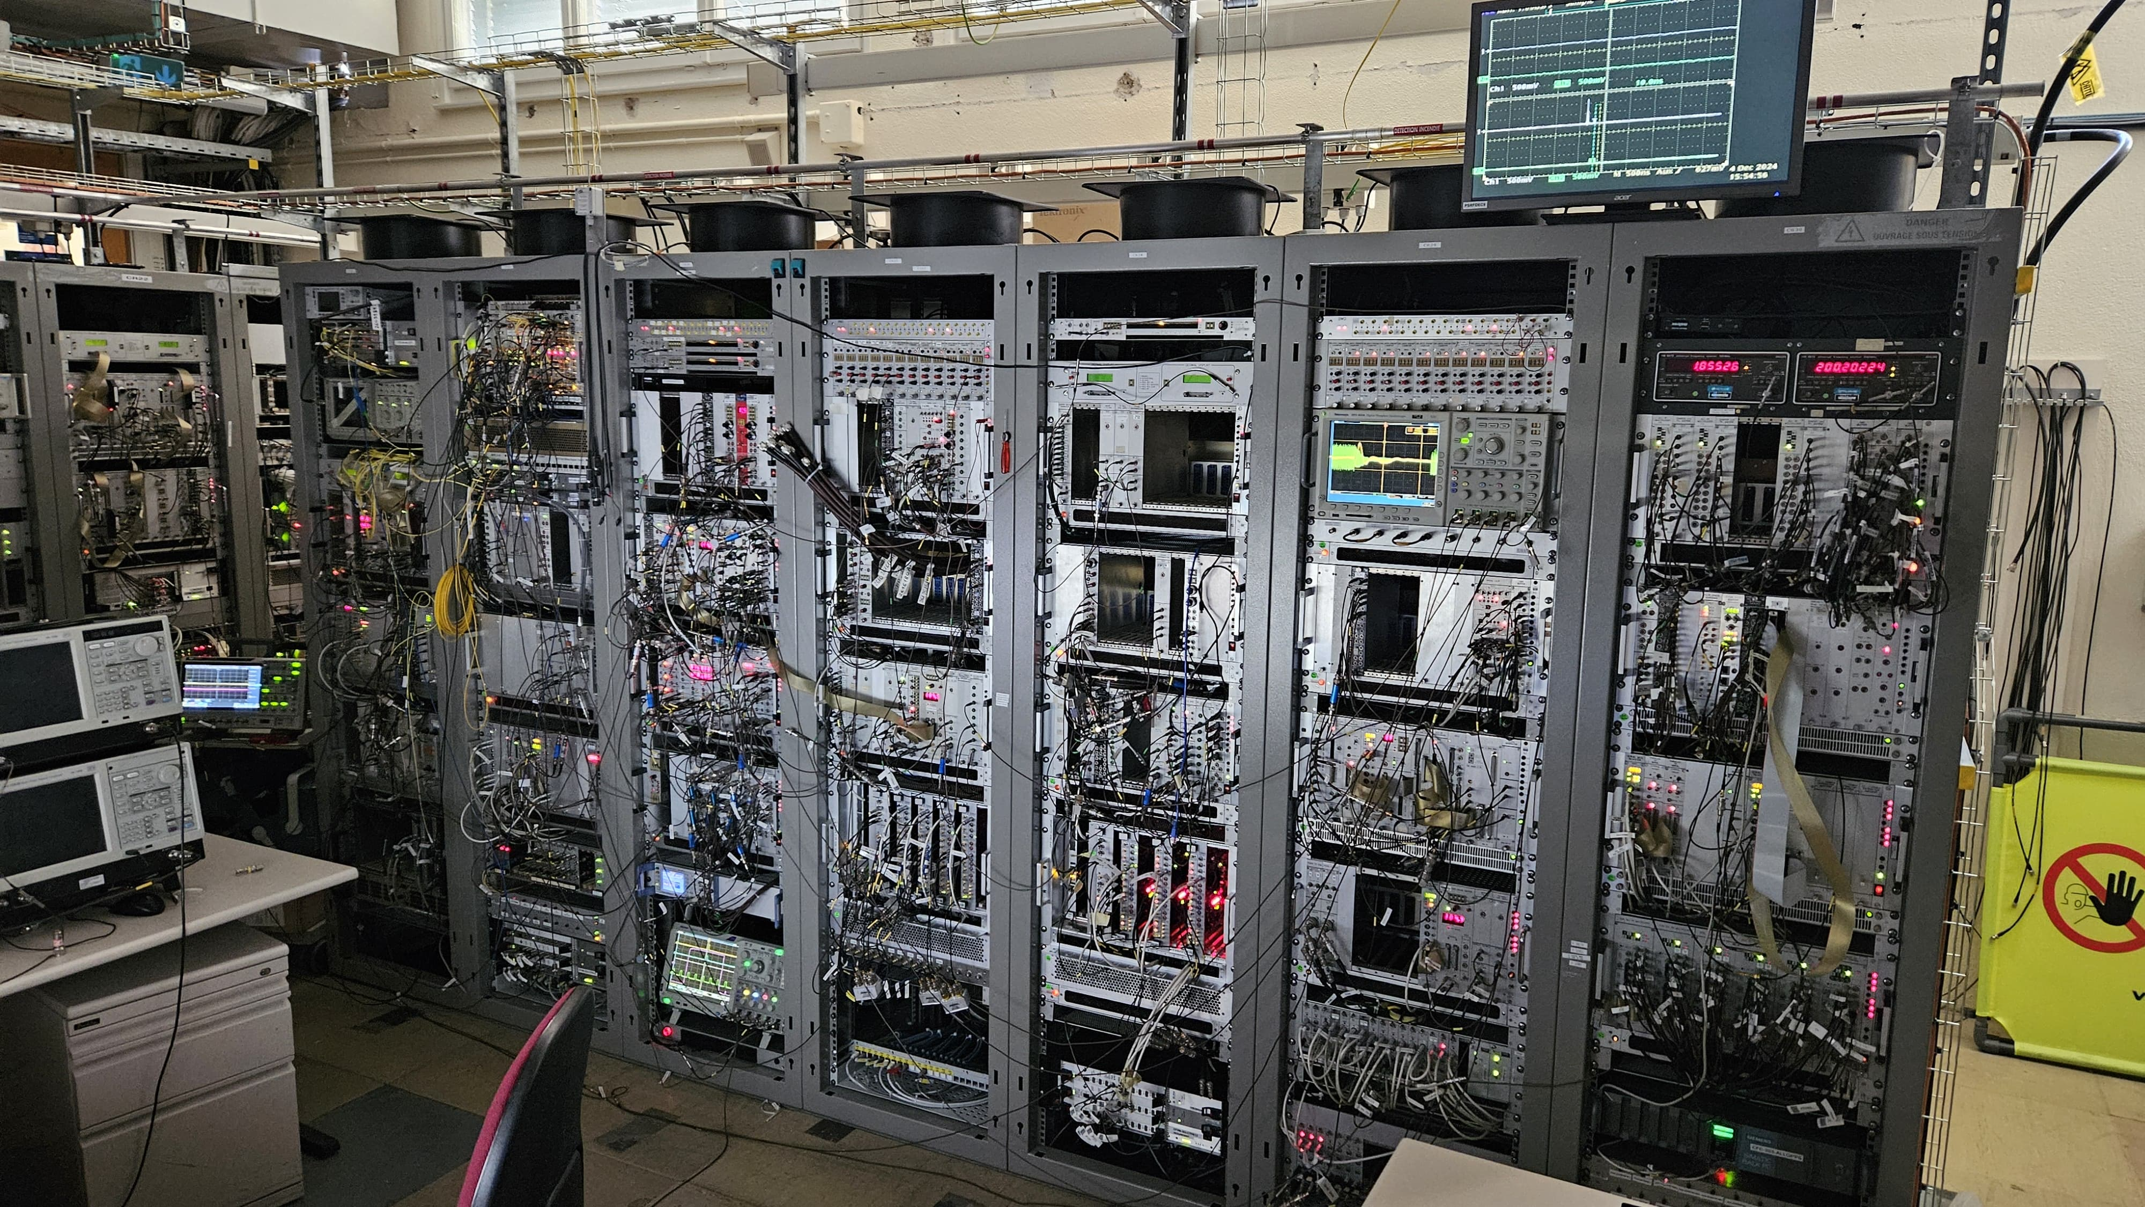
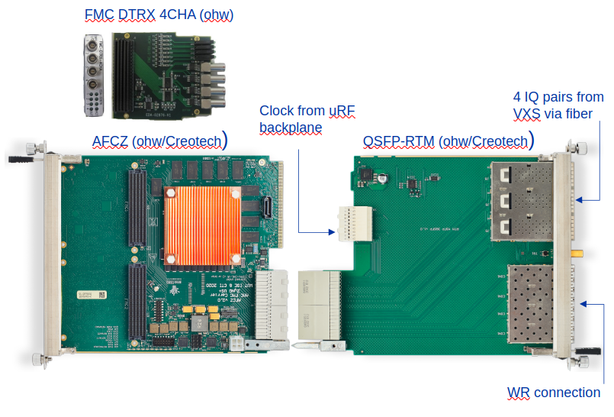
Ongoing activities: PS
PS beam control: Current system
Dates between 1970-2010: analog NIM and digital NIM/VME
Multiple instances of same/similar hardware that is switched for the different beam cycles
PS beam control: Upgrade
Use VXS system for signal acquisition + IQ demodulation
IQ data streams sent through VXS backplane to VXS switch over SFP to MicroTCA crate
MicroTCA crate with AFCZ Zynq UltraScale+ MPSoC x2 FMC Carrier (AFCZ also used for SPS & LHC beam control)
PS barrier bucket upgrades
New firmware to incorporate new features: such as H1 synchronisation to SPS, smooth harmonic switching and single turn acquisition
Fig – (part of) the current PS beam control
Fig – AFCZ FMC carrier and serial FMC
Fig – New VXS crate installation in PS central building

Slide 10
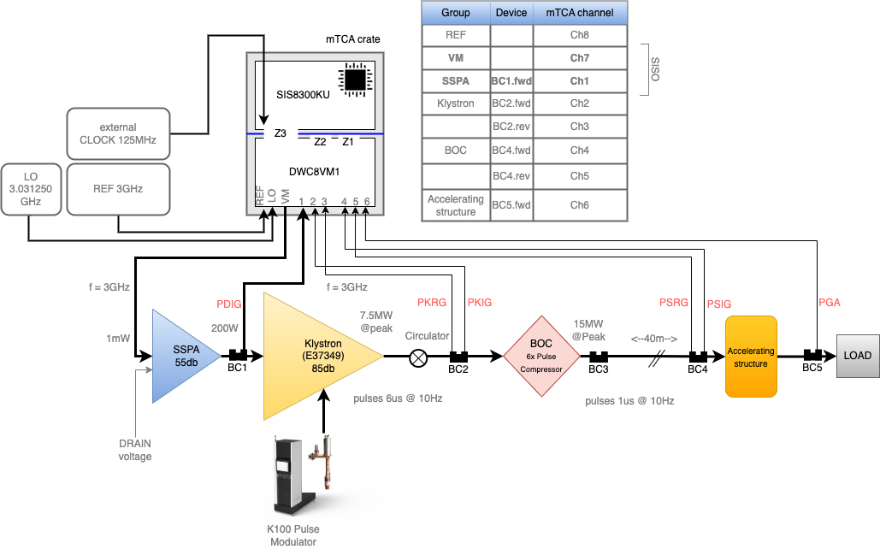
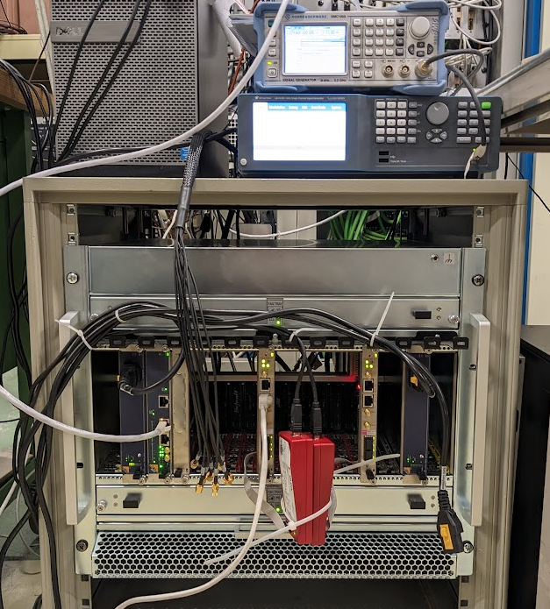
Ongoing activities: Electrons
AWAKE run 2c
Two electron sources: Electron injector linac and witness electron linac, synchronised to < 50fs
Ultra-low jitter/phase noise RF source
RF to RF to laser synchronisation
Highly stable (10 fs) RF distribution links
LLRF control: MicroTCA, testing at CLEAR
Installation in 2028
CLEAR
Continued extensions of CLEAR mean that much of the hardware is beyond end of life
Use CLEAR to test and deploy AWAKE run 2c hardware
AWAKE run 2c LLRF system at CLEAR

Slide 11
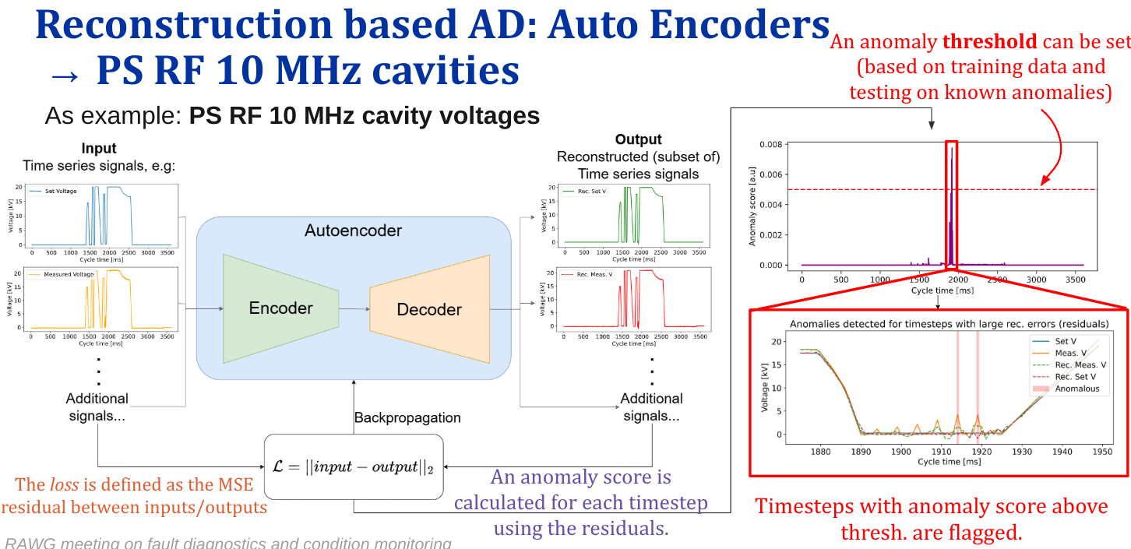
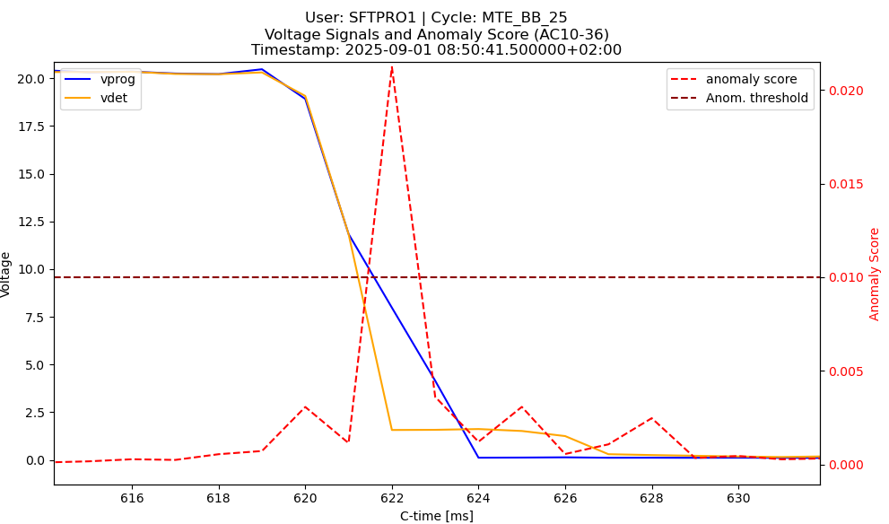
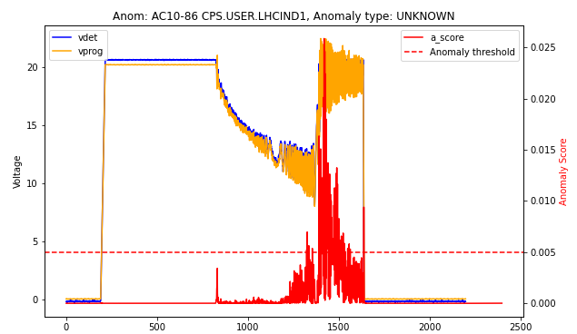
Ongoing activities: Efficient Particle Accelerators EPA: PS RF Anomaly detection
Status
Anomaly detection models for PS RF 10 MHz cavities demonstrated
Trained using 2024 September data, demonstrated capable of consistently identifying real anomalies in 2025.
Limited by access to signals
Base demonstrator: ML Auto-encoder
Deploy-able on CERN controls devices for online monitoring with logging
Implementation of multiple UCAP devices, released on test docker node.
Live monitoring Web app panels implemented
Model designed to be extendible to monitor further signals of interest, such as:
Low-level RF signals like phase discriminators, loop inputs (radial position), revolution frequency, etc.
High-level RF signals like amplifier driving currents, tuning phase errors, gap relay status.
External factors: B-field, beam intensity.
Illustration of model usage, RAWG meeting
Detected anomaly:
Early Gap relay closure
Detected anomaly:
Hereward damping oscillations

Slide 12
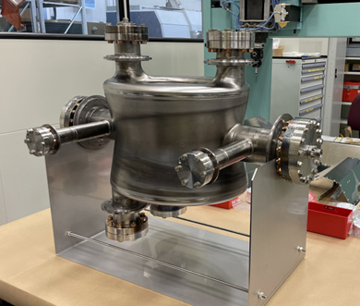
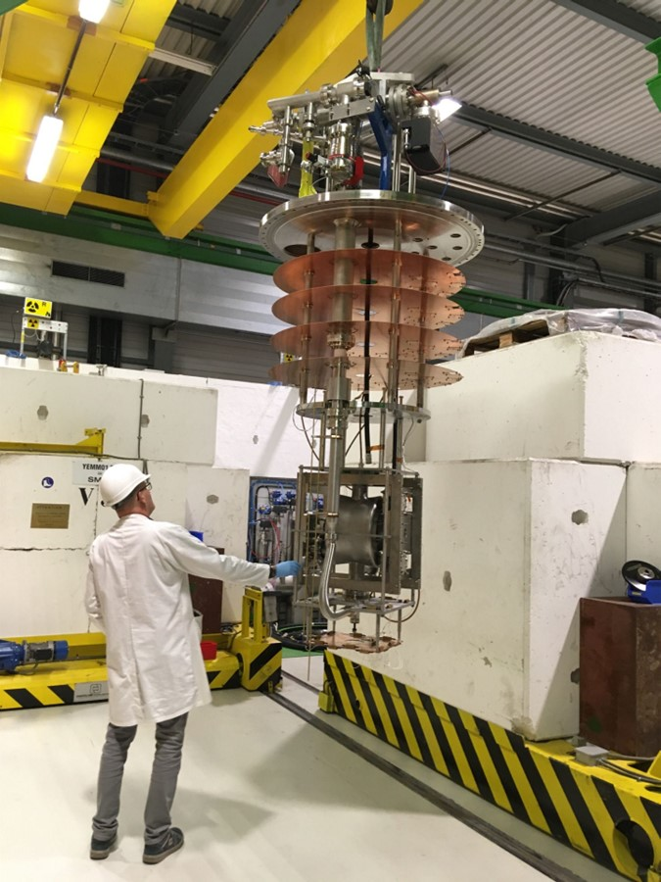
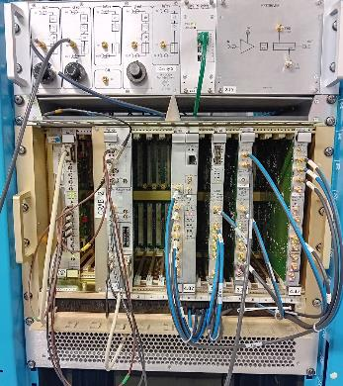
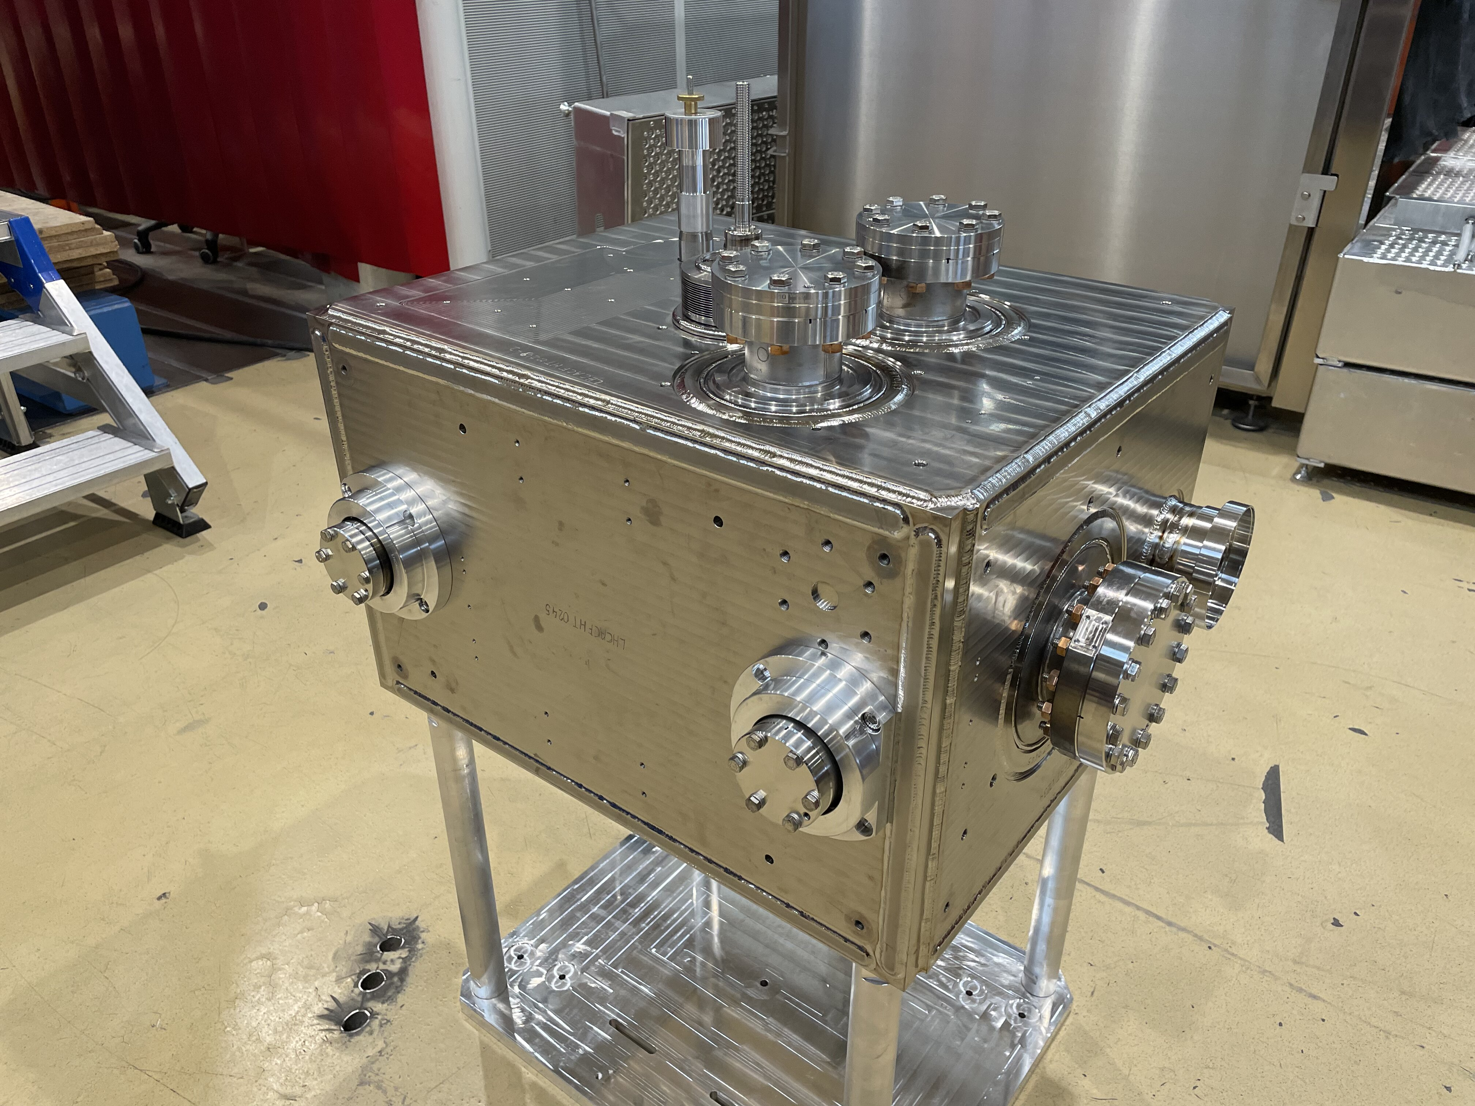
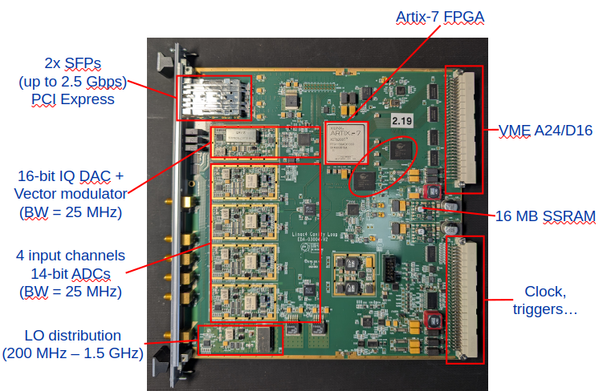
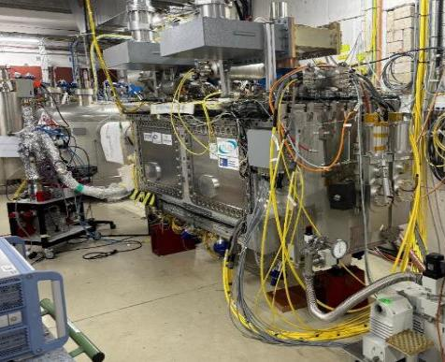
Ongoing activities: SRF cavity tests
Development and validation of SRF Cavities at SM18 (LHC, HL-LHC crabs, FCC proto, R&D...)
Measurement of high quality factor SRF cavities (Q0 in 10⁸ - 10¹¹ range)
CERN has a variety of cavities with frequencies ranging from 101 -1300 MHz
LLRF framework must be adaptable to any given cavity type and specific R&D needs
Both pulsed and continuous powering operational modes
Self-Excited Loop and Generator Driven modes required
Development of a “Universal Cavity Controller” UCC

Slide 13
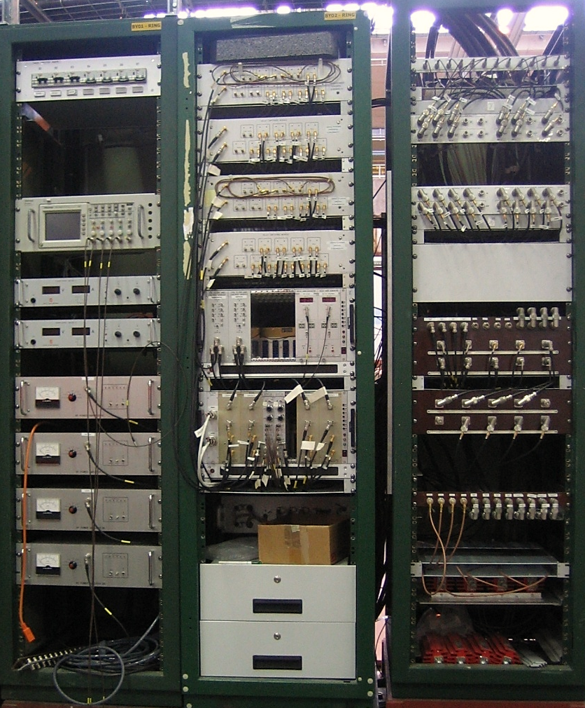
Upcoming activities LS3 and beyond
LEIR transverse damper
Obsolete components, expertise retired/to soon retire
New damper topology (fixed clock?, MicroTCA based) to be rolled out across all transverse dampers in need of consolidation over the coming years.
REX and LINAC3
Consolidation of RF amplifiers and controls
Consolidation of 202 MHz LLRF to MicroTCA (can use SPS LLRF HW, new FW needed)
AD
C10 consolidation – MicroTCA
Stochastic cooling – Custom analog electronics
LHC beam control Phase 1: To start in 2027/28
Implementation of full White Rabbit/MicroTCA based Beam control à la SPS.
Replace all original RF-VME hardware (Beam phase module, Beam loops module, synchro module) with MicroTCA and VMEx64.
LEIR Transverse Damper Controls Hardware

Slide 14
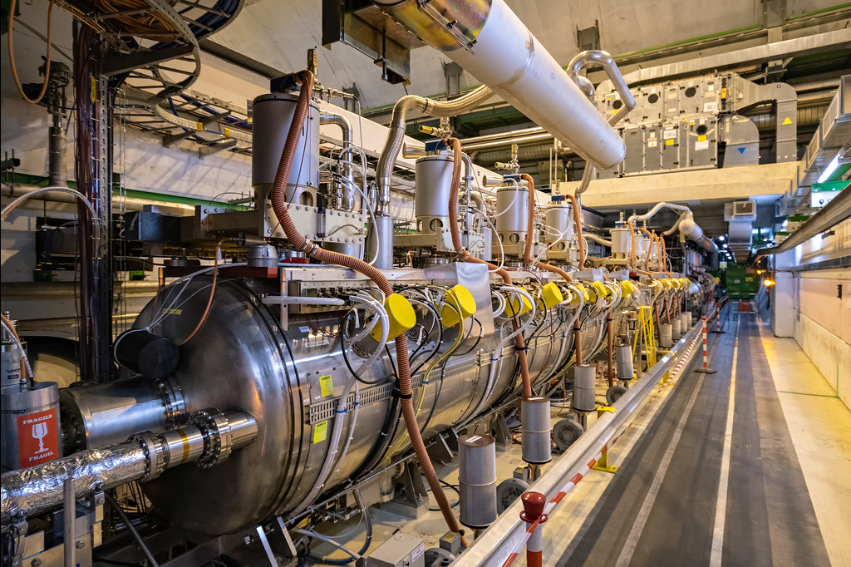
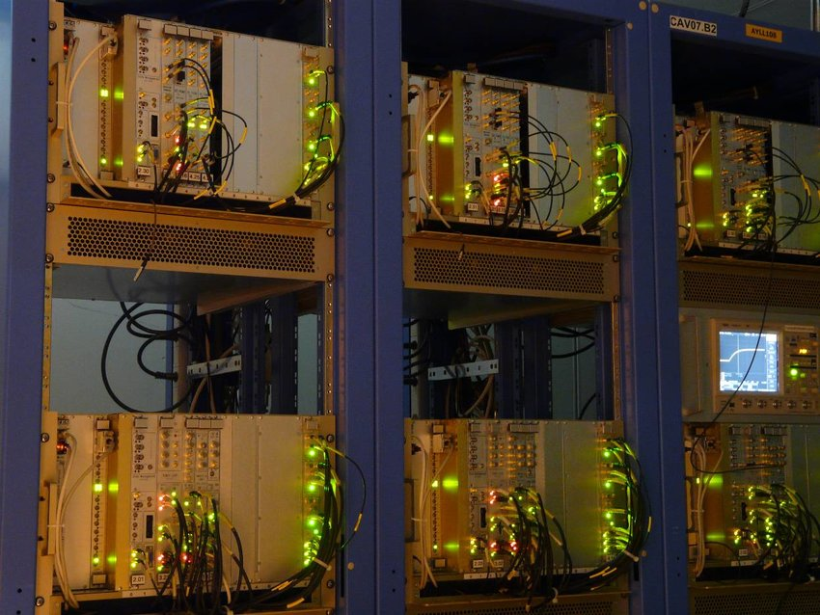
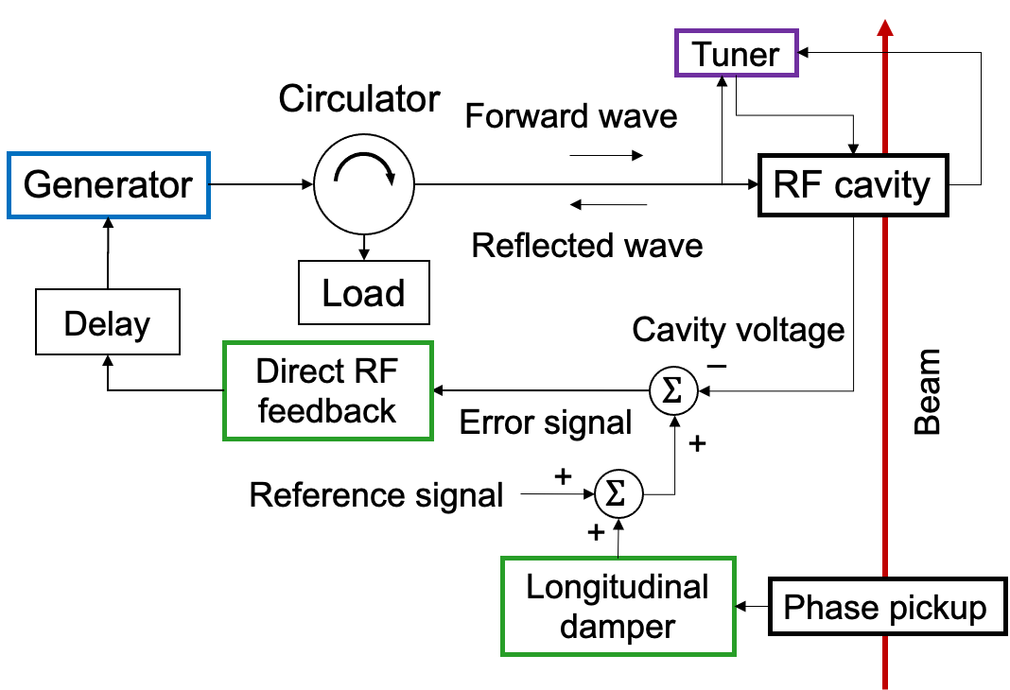
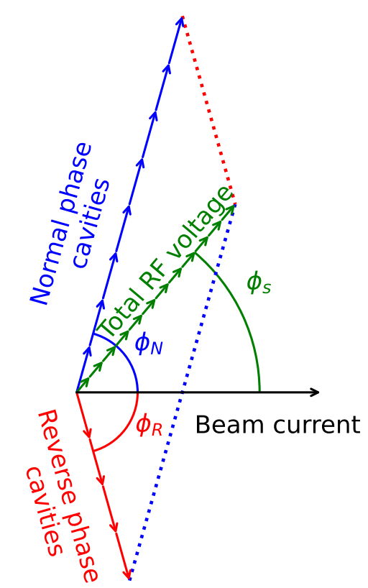
Activities: Run4 and Beyond
LHC ACS consolidation
RF-VME standard was created for LHC. Development mid 2000’s
Hardware is obsolete, spares situation is not ideal
Renovating the cavity controller with modern hardware and techniques could improve maintainability and standardise across multiple machines
FCC-ee cavity controller
Same frequency as LHC; 400 MHz. High beam current with impedance reduction feedback (direct FB, one-turn delay feedback, Feed-forward/Longitudinal damper)
Reverse phase operation for Z boson production
Development would keep expertise at CERN for the development of such a system
Development during run4 (2030’s): Can be used for testing of the FCC prototype cavities
LHC ACS cavities in tunnel
LHC ACS cavity controllers
FCC RF system design

Slide 15
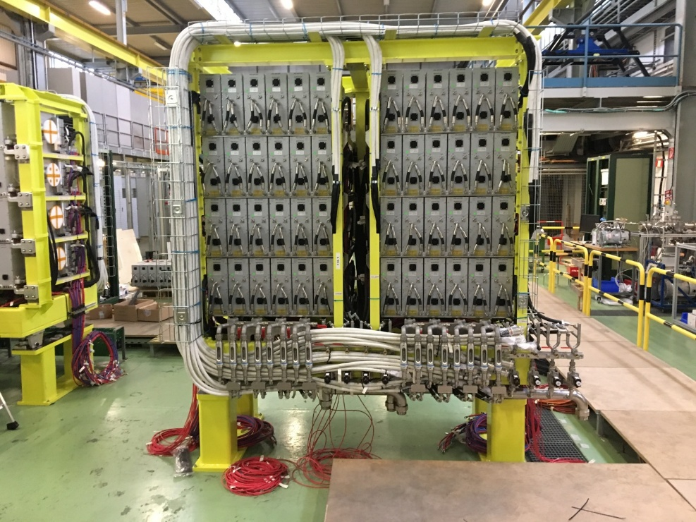
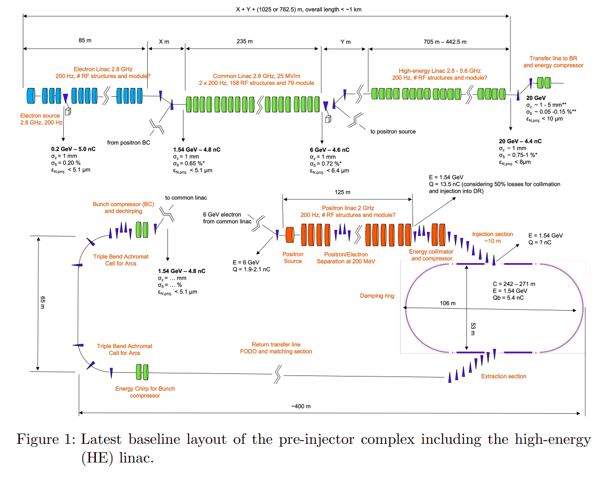

Activities: Run4 and Beyond
Small injectors LLRF consolidation
PSB, LEIR, AD/ELENA (and PS to some extent)
Since the injectors will carry on past 2040s, consolidation/upgrade of the systems is required.
New generation/family of cavity and beam controllers for these machines is required.
Technology family?
LINACs
A new generation of LLRF for LINACs will be required in the context of consolidation and FCC injector
Consolidation:
LINAC3 and REX/ISOLDE has controllers dating to 2000s or earlier
LINAC4 hardware will be 20 years old at the start of run 5
FCC-ee injector
Shares many aspects with AWAKE 2c LLRF system
Scalability/cost will have to be optimised.
PSB Finemet Cavities
FCC injector complex

Slide 16
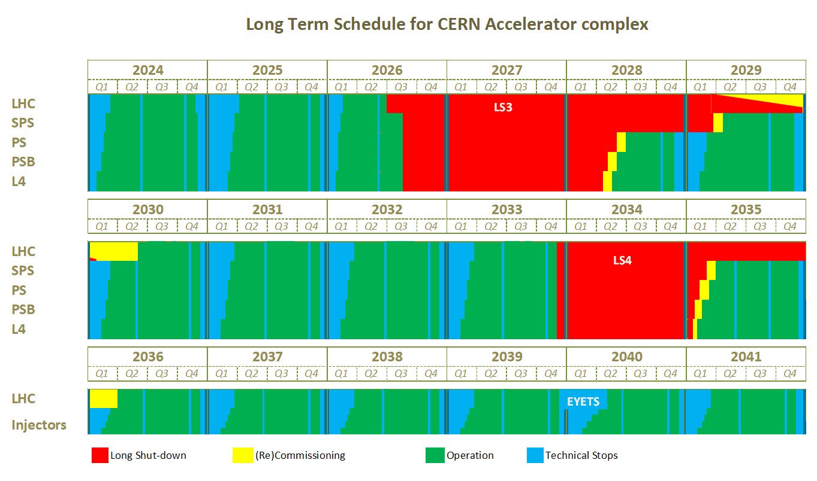

Slide 17
CERN Talks and Posters @ LLRF2025
Reverse phase operation for CERN's FCC-ee 400 MHz RF system: Increasing flexibility brings challenges for cavity control – Ivan Karpov, Monday 14:55
A Universal Cavity Controller for testing SRF cavities at CERN – Diego Barrientos, Tuesday 11:30
Initial commissioning of the new beam control system of the Proton Synchrotron at CERN – Diego Barrientos – Poster, Tuesday 14:10
Noise feedback system for Crab Cavities in Large Hadron Collider – Daniel Valuch, Wednesday, 9:05
Upgrade of the Barrier Bucket LLRF system for High-Intensity, Low-Loss Multi-Turn Extraction at the CERN PS -Toma Gavric, Wednesday 11:10
Electromagnetic compatibility. Does it matter when everything is digital anyway? – Daniel Valuch, Wednesday 13:20
Anomaly Detection in the CERN Proton Synchrotron RF Systems Using Machine Learning - Joel Wulff, Wednesday 14:30

Slide 19
Extra Slides

Slide 20

System Standards
For the RF control systems we typically have centralised systems, requiring tight synchronisation and interfaces.
Shared clocks, triggers, high data throughput between systems (I.e. Beam controls and cavity control)
This pushes us to use highly integrated systems, like crates (backplane) able to carry multiple cards
VME, VXS, PXI (test stands) and MicroTCA.
Current state of the art (in RF) is MicroTCA
Well supported, widely used (outside of CERN)
CERN controls group support the standard
We (RF + controls) developed the first use at CERN.
For now, this is the preferred standard in RF for new systems.
Fig – SPS Cavity controllers C800 (Left, RF-VME), C200 (Center-Right, MicroTCA)

Slide 21
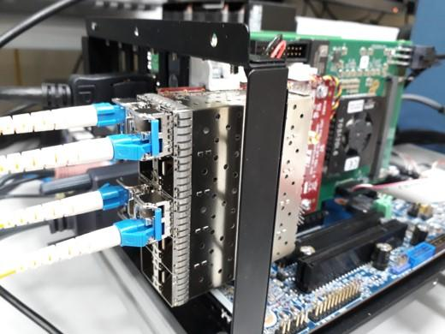
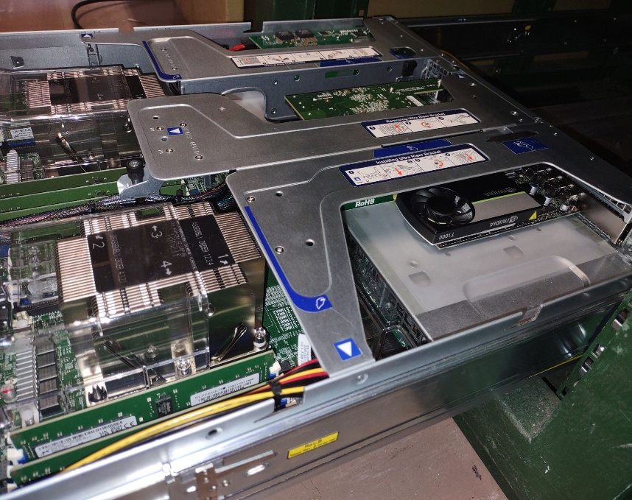
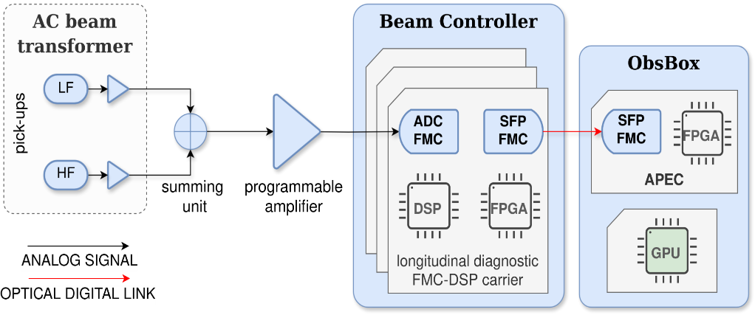
The ObsBox
RF developed solution using various COTS hardware with custom firmware and software.
GTP links stream data from LLRF beam control systems to server.
Real-time data processing to obtain beam properties:
Bunch length/position
Momentum spread
Tomography
Spectra
APEC (Advanced PCIe FMC Carrier) card
off the shelf acquisition card
10 port SFP+ FMC mezzanine
Trenz Electronics FMC carrier
Xilinx Virtex 7 FPGA
PCIe 3.0 x8
custom firmware and driver developed in the RF group
Used with 2 channels @ 2 Gbps
2* Intel Xeon 2.10 GHz, 16 cores
128 GB ram
APEC
PCIe Timing Receiver Card (CTRIE)
NVIDIA T1000 GPU
4 GB GDDR6
896 CUDA Cores
CentOS 7, standard CERN’s FEC OS

Slide 22
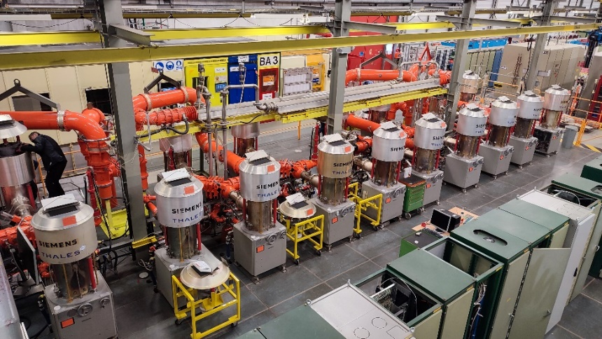
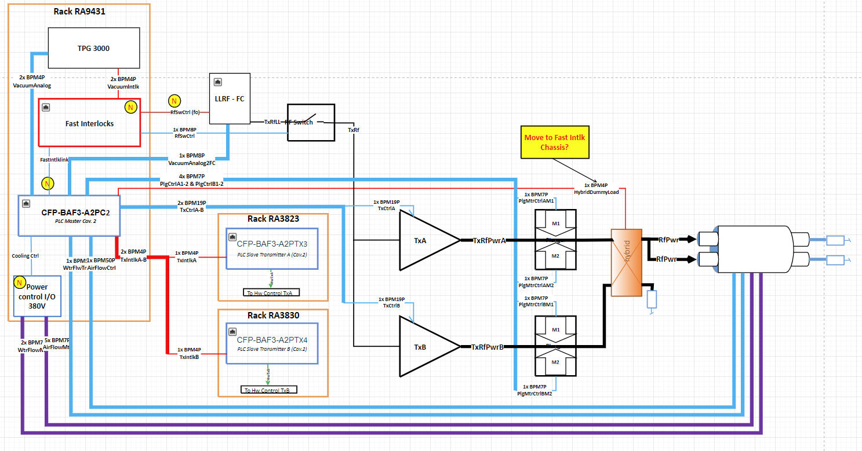
Ongoing Consolidation items: High Power Controls
SPS 200MHz HLRF Controls for Philips and Siemens RF power plants
To be completed in LS3
Bring them up to date with the Thales SSA system
LHC ACS HLRF Controls
To be completed in LS3
SM18 prototype installed, testing in progress
In parallel on OP budget, the ADT power system will also be upgraded.
Siemens amplifiers and control

Slide 23
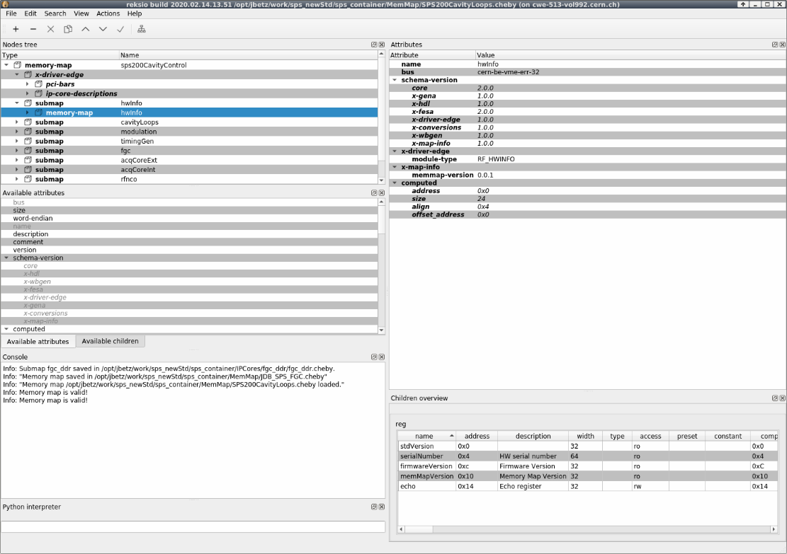
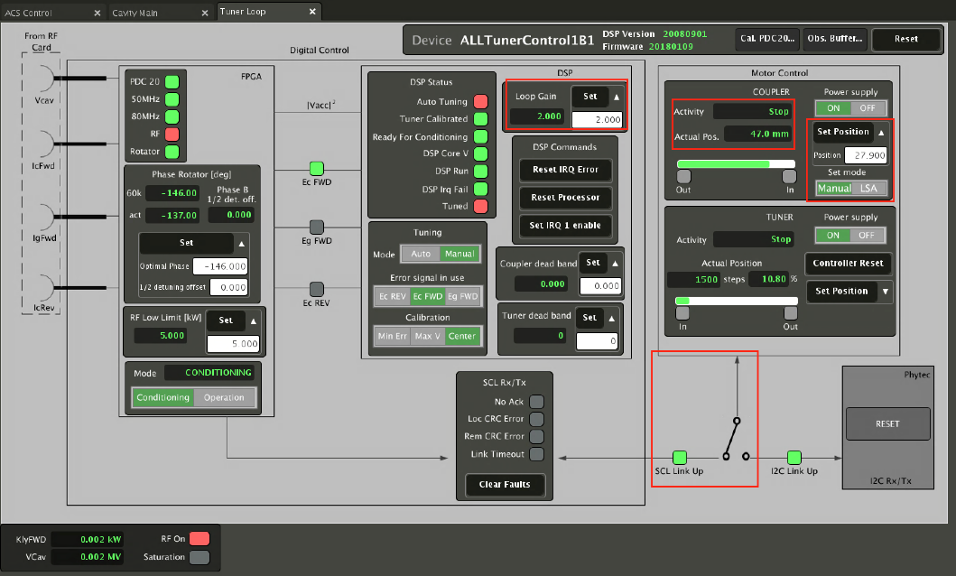
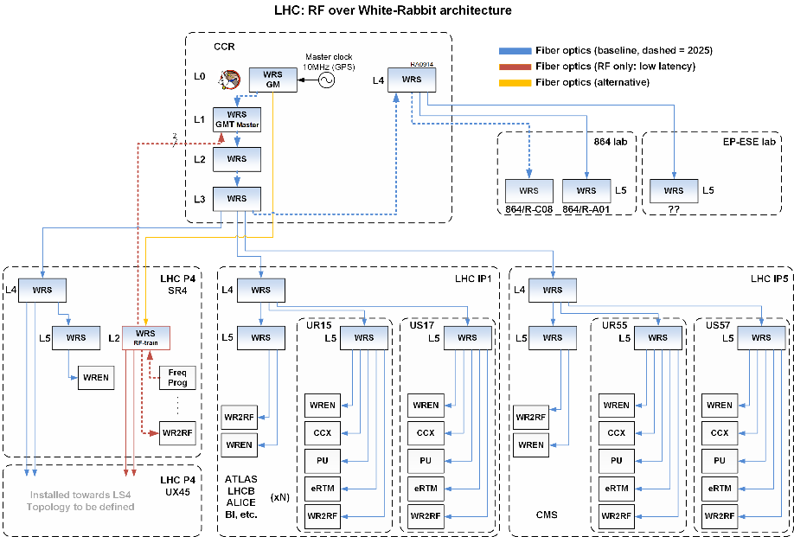
Interfaces to other groups
Timing/Controls
Machine timing – CTRs -LTIMs
Firmware and software development tools – Cheby, REKSIO
Ips – General Cores, WRCore, PCI, AXI, VME cores..,
GUIs – Java, Inspector, PyQt, WRAP…
White Rabbit
RF over WR: SPS (LS2), LHC and PS(ongoing/LS3)
B-Train over WR: Majority of machines
Beam Instrumentation
Phase and radial pickups
Beam Quality monitors
EPC
EPC power supplies
Voltage or Frequency programs (LHC)
IT
CI/CD - CI4FPGA
EDA tools
Virtual machines

Slide 24
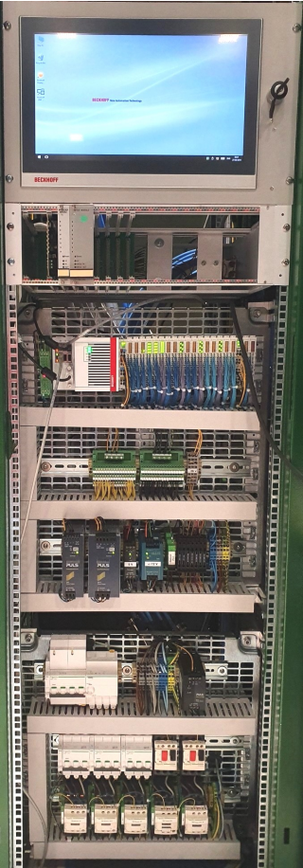
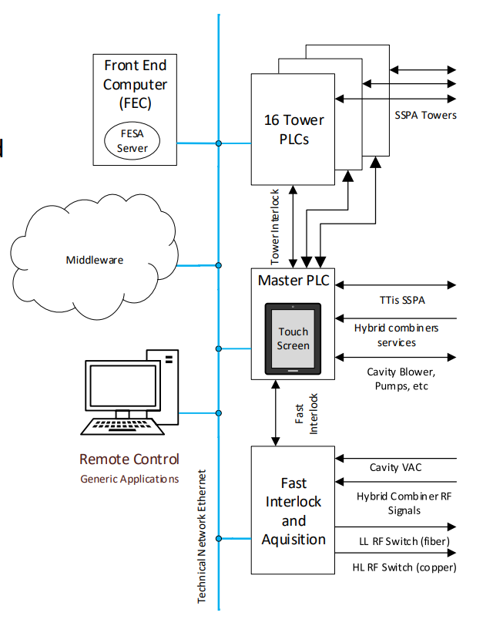
PLCs – RF high power and interlocks
PLC control for High power systems and interlocks
Mix of Siemens (obsolete) and Beckhoff (new RF standard)
Ongoing consolidation requests to roll out Beckhoff systems (SPS and LHC)
Remote control is implemented using the standard tools from CERN’s Controls group
Fast interlock systems
Based on Beckhoff fast interlock modules in PLC
Hardware logic independent of PLC CPU
Flexibility, monitoring and remote control
Will be used for HL-LHC crab cavity watchdog interlock system
SPS Thales SSA Controls layout

Slide 25
RF Systems around the complex
CONS Approved
CONS Requested
Accelerator | System | Technology Family | Year of production | Obsolete | Planned CONS
Linac 4 + RFQ2 | Source | VME misc | 2015 | Y | N
 | Chopper control | RF-VME | 2014 | Y | N
 | Cavity control and tuner | RF-VME | 2014 | Y | N
Linac 3 | Cavity control 101MHz | RF-VME | 2020 | Y/N | N
 | Cavity control 202MHz | NIM/Analog | 1994 | Y | Y(LS3)
LEIR | Beam/cavity control | VXS | 2010 | Y/N | Y(LS4 or beyond)
 | Transverse damper (ADT) | Analog custom | 2005 | Y | Y(LS3)
PSB | Beam/cavity control | VXS | 2010 | Y/N | Y(LS4 or beyond)
 | ADT | RF-VME | 2010 | Y | Y(LS4)
ISOLDE | Cavity Control | RF-VME | 2020 | Y/N | N
 | REX | Analog | 2000 | Y | Y(LS3/early Run4)
PS | Main beam control | NIM + VME +RF-VME | 1970-2000s | Y | Y(LS3)
 | Cavity controllers and ADT | RF-VME | 2010 | Y | Y(LS4)
 | C200 | Custom + NIM | 1970s | Y | Y(LS3/early Run4)

Slide 26
Accelerator | System | Technology Family | Year of production | Obsolete | Planned CONS
AD/ELENA | Beam control and Cavity Control | VXS | 2010 | Y/N | Y(LS4 or beyond)
 | C10 Cavity Control | NIM/Analog custom | 1990s | Y | Y(LS3/early Run4)
SPS | Beam Control | MicroTCA | 2018 | N | N
 | C200 Cavity Control | MicroTCA | 2018 | N | N
 | C800 Cavity Control | RF-VME | 2012 | Y | Y(LS4 or beyond)
 | Crab Cavities BA6 | RF-VME | 2015 | Y | N
 | Transverse damper (ADT) | RF-VME | 2018 | Y/N | N
AWAKE | RF Reference generation | RF-VME | 2015 | Y | Y(LS3 Awake proj)
 | Electron linac Cavity Control | Custom Analog + VME | 1980-2010s | Y | Y(LS3 Awake proj)
LHC | Beam Control | RF-VME | 2006 | Y | Y(LS3)
 | Cavity Control | RF-VME | 2006 | Y | Y(Run4/LS4)
 | ADT | RF-VME | 2018 | Y/N | N
SM18 | Various Cavity controllers | RF-VME | 2006-2010s | Y | Y(LS3)
CLEAR | Cavity controllers | Analog custom +VME | 1980s | Y | Y(LS3 OP BC)
 | RF distribution | Analog custom + VME | 2000s | Y | Y(LS3 OP BC)

